Slide 1
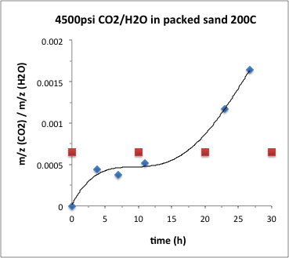
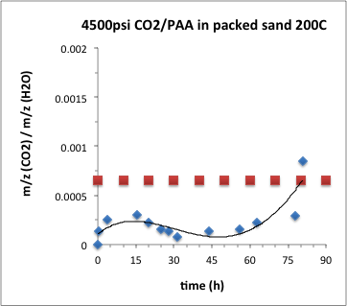
CO2 diffusion/convection through fractures
Experiments on a vertical 15.8”long x 0.245” diameter sand-packed column (particle size 20/30 mesh, 600-850μm) filled with water or StimuFrac fluid (PAA 1wt% in water) were performed after validation (red plot = bkg CO₂ conc. in water as measured and from reference¹)
CO₂ breakthrough on
the other side of the column.
In both cases mainly
diffusion-based transport,
no convection
Assuming CO₂ BKG
concentration (red plot) in
StimuFrac solution is similar
to pure water though it
should be about 5% lower⁽¹⁾
Water
StimuFrac (PAA 1wt%)
Preliminary results indicate that diffusion of CO₂ in PAA solution takes significantly longer times (~80h to breakthrough) than in plain water (breakthrough observed at ~20h)
Experiments on an horizontal column were proposed where convection should play a critical role on speeding up CO₂ transport. Results in next slide.
(1) Z. Dian et al. Chemical Geology 193 (2003) 257–271
Notes:
Labs should only fill out the relevant quarters. Please feel free to expand this to 2 slides if necessary.

Slide 2
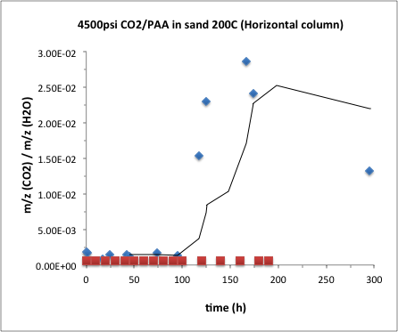
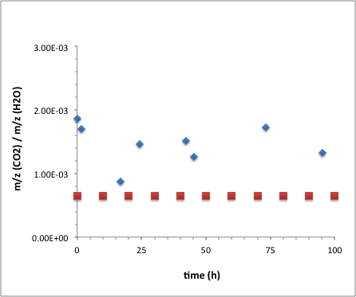
CO2 diffusion/convection through fractures (cont.)
CO2 transport experiments in a horizontal (15.8”long x 0.245” diameter) sand-packed column (particle size 20/30 mesh, 600-850μm) filled with StimuFrac fluid (PAA 1wt% in water) were performed to determine CO2 breakthrough times when CO2 transport occur by both, diffusion and convection.
CO₂ BKG
concentration
(red plot)
StimuFrac (PAA 1wt%): Diffusion only transport
StimuFrac (PAA 1wt%): Diffusion + Convection
Although the concentration of CO2 in the horizontal column is higher than the background concentration at all times which make conclusions difficult to draw, the breakthrough time when both, diffusion and convection (right plot), transport mechanisms take place is similar to the breakthrough time obtained when diffusion only transport occur, about 80-90h.
Notes:
Labs should only fill out the relevant quarters. Please feel free to expand this to 2 slides if necessary.

Slide 3
Proposed Injection alternatives for StimuFrac
Two alternatives for deployment of StimuFrac are suggested:
A. Co-injection of polymer solution and liquid CO₂ to maximize mixing and reactivity/
volume expansion
B. Utilization of an alternative source of CO₂, sodium bicarbonate, which was shown in
FY15 to decompose to CO₂ at EGS temperatures triggering volume expansion
of StimuFrac.

